Slide 1
Introduction to AI

Slide 2
Introduction to AI
Definition Of AI
Example Systems
AI Problems
AI Techniques
Problem Solving By Searching

Slide 3
What is AI?
It is concerned with the design of intelligence in an artificial device.
What is intelligence?
-Behaves as Intelligently as a human
-Behave in the best possible manner
-Thinking?
- Acting?

Slide 4
Approaches to AI
Thought /Reasoning
System that
think like Human
System that
think like Rationally
Human Like
Performance
Ideal
Performance
System that
act like Human
System that
act like Rationally
Behaviour

Slide 5
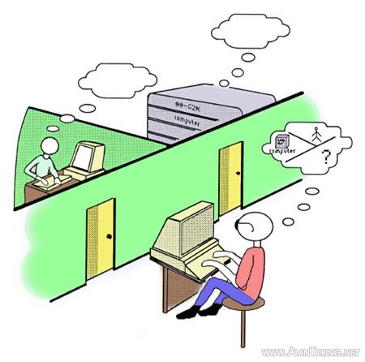
Turing Test
If the interrogator cannot reliably distinguish between human and computer , then the computer does posses intelligent

Slide 6
Typical AI Problems
Intelligent entities(or agents) need to be able to do both “mundane” and “expert” tasks:
Mundane tasks:
Planning Route
Reorganization people, objects
Communication (through natural language)
Navigation round obstacles on the street
Expert Tasks:
Medical Diagnosis
Mathematical Problem Solving

Slide 7
Intelligent Behavior
Perception
Reasoning
Learning
Understanding Language
Solving Problems
These things are examples of some of the things that we want our AI systems
to solve the problem.

Slide 8
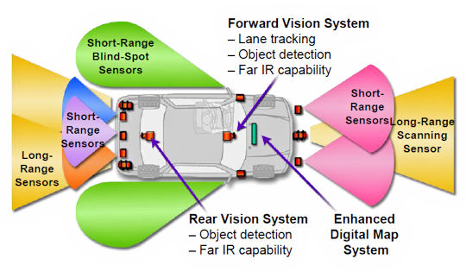
What AI can do today?
Autonomous Land Vehicle

Slide 9
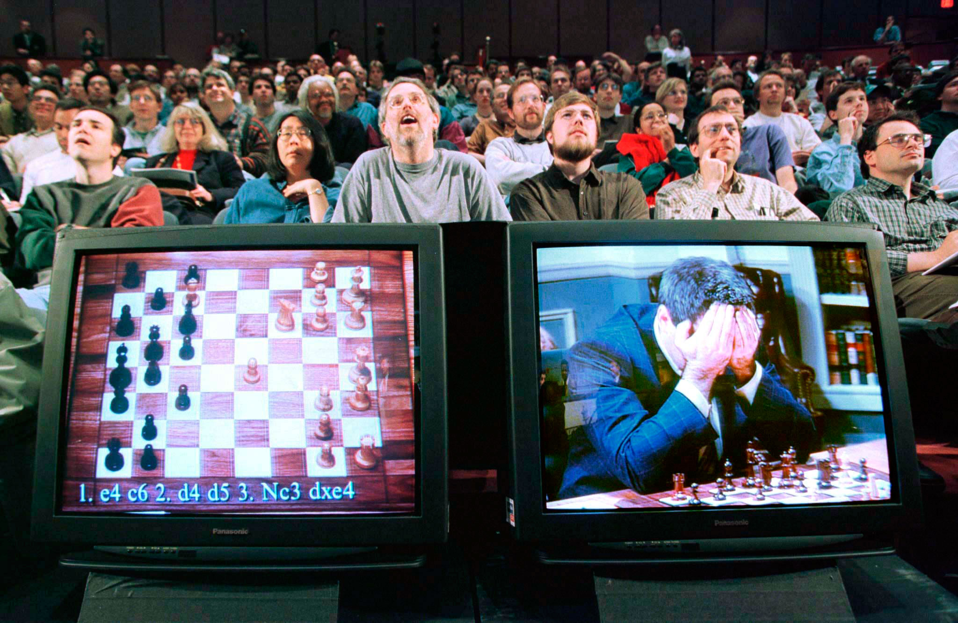
What AI can do today?
Deep Blue

Slide 10
AI Techniques
Path finding is often associated with AI, because the A* algorithm and many other path finding algorithms were developed by AI researchers.
Neural Networks model a brain learning by example―given a set of right answers, it learns the general patterns.
Fuzzy Logic
Genetic Algorithm : It is a search technique used in computing to find true or approximate solutions to optimization and search problems.

Slide 11
Limits Of AI Today
Today’s successful AI systems:
-operate in well – defined domain
-Employ narrow , specialized knowledge
Commonsense Knowledge
-needed in complex, open-ended worlds
- Understand unconstrained Natural Language

Slide 12
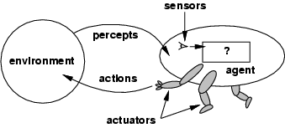
3
Agents
•
An agent is anything that can be viewed as
–
–
–
perceiving its environment through sensors and
acting upon that environment through actuators
Assumption: Every
agent
can
perceive
its
own
actions
(but
not
always
the
effects)

Slide 13
4
Agents
•
Human agent:
–
–
eyes, ears, and other organs for sensors;
hands,legs, mouth, and other body parts for actuators
•
Robotic agent:
–
–
cameras and infrared range finders for sensors;
various motors for actuators
•
A
–
–
software agent:
Keystrokes, file contents, received network packages
Displays on the screen, files, sent network packets as
as sensors
actuators

Slide 14
5
Agents and environments
•
Percept: agent’s perceptual input at any
given instant
Percept sequence: complete history of everything the agent has ever perceived
•
An agent’s behavior is described by the agent function which maps from percept histories to actions:
[f: P * → A]
Internally, the agent function will be implemented by an agent program which runs on the physical architecture to produce f
agent = architecture + program

Slide 15
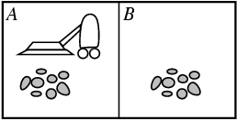
6
Vacuum-cleaner
world
•
•
•
Two locations: A and B
Percepts: location and contents, e.g.,
[A,Dirty]
Actions: Left,
Right, Suck,
NoOp
Percept sequence
[A,Clean]
[A, Dirty]
[B,Clean]
[B,Dirty]
[A,Clean],[A,Clean]
[A,Clean],[A,Dirty]
…
[A,Clean],[A.Clean],[A,Clean]
[A,Clean],[A,Clean],[A,Clean]
Actions
Right
Suck
Left
Suck
Right
Suck
…
Right
Suck
One simple function is :
if the current square is dirty
then suck, otherwise move
to the
other square

Slide 16
7
Rational agents
•
An agent should strive to "do the right thing", based on what it can perceive and
actions it can perform.
the
•
The right action is the one that will cause the agent to be most successful
•
Performance measure: An objective criterion for success of an agent's behavior
•
E.g., performance measure of a vacuum-cleaner agent could be:
amount of dirt cleaned up,
amount of time taken,
amount of electricity consumed,
amount of noise generated, etc.

Slide 17
8
Rationality
•
What is rational at any given time depends on four things
–
–
–
–
The
The The The
performance measure that defines the criterion
agent’s prior knowledge of the environment
of
success
actions that the
agent’s percept
agent can perform
sequence to date
–
Rational Agent: For
each possible percept sequence,
a
rational
agent should select an action that is expected to maximize its
performance measure, given the evidence provided by the
percept sequence and whatever built-in knowledge the agent
has.

Slide 18
9
Vacuum cleaner agent
•
Let’s assume the following
–
The performance measure awards one point for each clean square at each time step, over a lifetime of 1000 time steps
The geography of the environment is known a priori
The only available actions are Left, Right, Suck and NoOp
The agent correctly perceives its location and whether that location contains dirt
–
•
Under these circumstances the agent is rational:its
expected performance is at least as high as any other
agent’s

Slide 19
12
Specifying the task environment
(PEAS)
•
PEAS:
–
–
–
–
In
Performance measure,
Environment,
Actuators,
Sensors
designing an agent, the first step
•
must always
be to specify
the
task
environment
(PEAS)
as
fully
as
possible

Slide 20
13
PEAS for an automated taxi driver
•
Performance measure: Safe, fast, legal, comfortable trip, maximize profits
•
Environment: Roads, other traffic, pedestrians, customers
•
Actuators: Steering wheel, accelerator, brake, signal, horn
•
Sensors: Cameras, sensors, keyboard
sonar,
speedometer,
GPS,
odometer,
engine

Slide 21
14
PEAS for a medical diagnosis system
•
Performance measure: Healthy patient, minimize
costs, lawsuits
•
Environment: Patient, hospital, staff
•
Actuators: Screen display (questions, tests, diagnoses, treatments,
referrals)
•
Sensors: Keyboard
answers)
(entry
of
symptoms,
findings,
patient's

Slide 22
15
PEAS for a satellite image analysis system
•
Performance measure: correct image categorization
•
Environment: downlink from orbiting satellite
•
Actuators: display categorization
of
scene
•
Sensors:
color
pixel
arrays

Slide 23
16
PEAS for a part-picking robot
•
Performance measure: Percentage of parts in
correct
bins
•
Environment: Conveyor belt with parts,
bins
•
Actuators: Jointed arm
and hand
•
Sensors:
Camera,
joint
angle
sensors

Slide 24
18
PEAS for Interactive English tutor
•
Performance measure: Maximize student's score
on test
•
Environment: Set of students
•
Actuators: Screen display
(exercises,
suggestions,
corrections)
•
Sensors:
Keyboard

Slide 25
19
Environment types
•
•
•
•
•
•
Fully observable vs. partially
Deterministic vs. stochastic
Episodic vs. sequential
Static vs. dynamic
Discrete vs. continuous
observable
Single
agent
vs.
multiagent

Slide 26
20
Environment types
Fully observable vs. partially observable:
•
An environment is fully observable if an agent's sensors give it access to the complete state of the environment at each point in time.
Fully observable environments are convenient, because the
agent need not maintain any internal state to keep track of
the world
An environment might be partially observable because of
noisy and inaccurate sensors or because parts of the state
are simply missing from the sensor data
Examples: vacuum cleaner with local dirt sensor, taxi driver
•
•
•

Slide 27
21
Environment types
Deterministic vs. stochastic:
•
The environment is deterministic if the next state of the environment is completely determined by the current state and the action executed by the agent.
In principle, an agent need not worry about uncertainty in a fully observable, deterministic environment
If the environment is partially observable then it could appear to be stochastic
Examples: Vacuum world is deterministic while taxi driver is not
•
•
•

Slide 28
22
Environment types
Episodic vs. sequential:
•
In episodic environments, the agent's experience is divided
into atomic "episodes" (each episode consists of the agent
perceiving and then performing a single action), and the
choice of action in each episode depends only on the
episode itself.
Examples: classification tasks
•
•
In sequential environments, the current affect all future decisions
Examples: chess and taxi driver
decision
could
•

Slide 29
23
Environment types
Static vs. dynamic:
•
•
The environment is unchanged
while an agent is deliberating.
Static environments are easy to deal with because the agent need not
keep looking at the world while it is deciding on the action or need it worry about the passage of time
Dynamic environments continuously ask the agent what it wants to do
The environment is semi-dynamic if the environment itself does not
•
•
change with the passage of time but the agent's
does
Examples: taxi driving is dynamic, chess when semi-dynamic, crossword puzzles are static
performance score
•
played with a clock
is

Slide 30
24
Environment types
Discrete vs. continuous:
•
A limited number of distinct,
actions.
clearly defined states, percepts and
•
Examples: Chess has finite
number of discrete states, and has
discrete set of percepts
and
actions.
Taxi
driving
has
continuous
states,
and
actions

Slide 31
25
Environment types
Single agent vs. multiagent:
•
•
An agent operating by itself in an environment is single agent
Examples: Crossword is a single agent while chess is two-agents
•
Examples: chess is a competitive multiagent environment
While taxi driving is a partially cooperative multiagent environment

Slide 32
26
Environment
types
Task
Environment
Observable
Deterministic
Episodic
Static
Discrete
Agents
Crossword puzzle
Chess with a clock
Fully
Fully
Deterministic
Strategic
Sequential
Sequential
Static
Semi
Discrete
Discrete
Single
Multi
Poker
Backgammon
Partially
Fully
Stochastic
Stochastic
Sequential
Sequential
Static
Static
Discrete
Discrete
Multi
Multi
Taxi driving
Medical
Diagnosis
Partially
Partially
Stochastic
Stochastic
Sequential
Sequential
Dynamic
Dynamic
Continuous
Continuous
Multi
Single
Image Analysis
Part-picking robot
Fully
Partially
Deterministic
Stochastic
Episodic
Episodic
Semi
Dynamic
Continuous
Continuous
Single
Single
Refinery controller
Interactive
_{English Tutor}
Partially
Partially
Stochastic
Stochastic
Sequential
Sequential
Dynamic
Dynamic
Continuous
Discrete
Single
Multi
•
•
The environment type largely determines the agent design
The real world is (of course) partially observable, stochastic, sequential, dynamic, continuous, multi-agent

Slide 33
30
Agent types
•
Rather than a table how we can produce rational
behavior from a small amount of code
•
Four basic types in order of
increasing
generality:
–
–
–
–
Simple reflex agents
Model-based reflex agents
Goal-based agents
Utility-based
agents

Slide 34
31
Simple reflex agents
•
Select actions on the basis of the current percept
ignoring the rest of the percept history
•
Example: simple reflex vacuum cleaner agent
function REFLEX-VACUUM-AGENT([location,status]) returns an action
if status = Dirty then return Suck
else if location = A then return Right
else if location = B then return Left
•
•
Condition-action-rule
Example: if car-in-front-is-breaking breaking
then initiate-

Slide 35
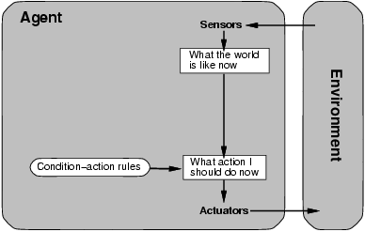
32
Simple
reflex
agents

Slide 36
33
Simple reflex agents
function SIMPLE-REFLEX-AGENT(percept) returns an action
state <-- INTERPRET_INPUT(percept) rule <-- RULE_MATCH(state, rules) action <-- RULE_ACTION[rule]
return action
static: rules, a set if condition-action rules
•
Simple-reflex agents are simple, but they
to be of very limited intelligence
turn out
•
The agent will work only if the correct decision
can be made on the basis of the current percept –
that is only if the environment is fully observable
Infinite loops are often unavoidable – escape could be possible by randomizing
•

Slide 37
34
Model-based reflex agents
•
•
The agent should keep track of the part of the world it can't see now
The agent should maintain some sort of internal state that depends on the percept history and reflects at least some of the unobserved aspects of the current state
Updating the internal state information as time goes by requires two kinds of knowledge to be encoded in the agent program
•
–
Information about how the world evolves independently of the agent
–
Information about how the agent's own
actions
affects
the
world
•
Model of the world – model based agents

Slide 38
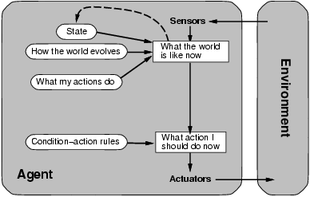
35
Model-based
reflex
agents

Slide 39
36
Model-based reflex agents
function REFLEX-AGENT-WITH-STATE(percept) returns an action
static:
state, a description of the current world state
rules, a set of condition-action rules
action, the most recent action, initially none
state <-- UPDATE_INPUT(state, action, percept)
action <-- RULE_ACTION[rule]
return action
rule <-- RULE_MATCH(state, rules)

Slide 40
37
Goal-based agents
•
Knowing about the current state of the environment is not always enough to decide what to do (e.g. decision at a road junction)
The agent needs some sort of goal information that describes situations that are desirable
The agent program can combine this with
•
•
information about the results of possible actions order to choose actions that achieve the goal
in
•
Usually
requires
search
and
planning

Slide 41
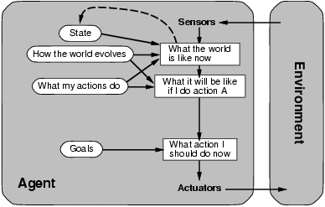
38
Goal-based
agents

Slide 42
39
Goal-based agents vs reflex-based agents
•
Although goal-based agents appears less efficient, is more flexible because the knowledge that supports its decision is represented explicitly and can be modified
On the other hand, for the reflex-agent, we would have to rewrite many condition-action rules
The goal based agent's behavior can easily be changed
it
•
•
•
The reflex situation
agent's
rules
must
be
changed
for
a
new

Slide 43
40
Utility-based agents
•
Goals alone are not really enough to generate high quality behavior in most environments – they just provide a binary distinction between happy and unhappy states
A more general performance measure should allow
a comparison of different world states according to
exactly how happy they would make the agent if
they could be achieved
Happy – Utility (the quality of being useful)
A utility function maps a state onto a real number which describes the associated degree of happiness
•
•
•

Slide 44
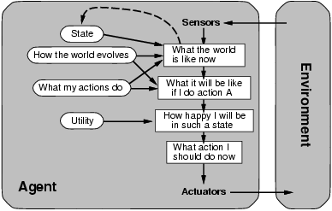
41
Utility-based
agents

Slide 45
42
Learning agents
•
Turing – instead of actually programming intelligent machines by hand, which is too much work, build learning machines and then teach them
Learning also allows the agent to operate in initially
unknown environments and to become more
competent than its initial knowledge alone might
allow
•

Slide 46
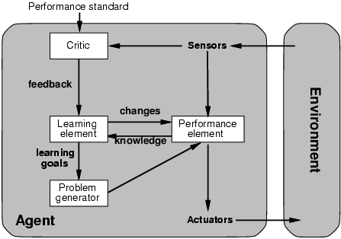
43
Learning
agents

Slide 47
Summary: agent types
(1) Table-driven agents
use a percept sequence/action table in memory to find the next action. They are implemented by a (large) lookup table.
(2) Simple reflex agents
are based on condition-action rules, implemented with an appropriate production system. They are stateless devices which do not have memory of past world states.
(3) Agents with memory - Model-based reflex agents
have internal state, which is used to keep track of past states of the world.
(4) Agents with goals – Goal-based agents
are agents that, in addition to state information, have goal information that describes desirable situations. Agents of this kind take future events into consideration.
(5) Utility-based agents
base their decisions on classic axiomatic utility theory in order to act rationally.
(6) Learning agents
they have the ability to improve performance through learning.

Slide 48
Summary
An agent perceives and acts in an environment, has an architecture, and is implemented by an agent program.
A rational agent always chooses the action which maximizes its expected performance, given its percept sequence so far.
An autonomous agent uses its own experience rather than built-in knowledge of the environment by the designer.
An agent program maps from percept to action and updates its internal state.
Reflex agents (simple / model-based) respond immediately to percepts.
Goal-based agents act in order to achieve their goal(s), possible sequence of steps.
Utility-based agents maximize their own utility function.
Learning agents improve their performance through learning.
Representing knowledge is important for successful agent design.
The most challenging environments are partially observable, stochastic, sequential, dynamic, and continuous, and contain multiple intelligent agents.

Slide 49
Solving problems by Searching

Slide 50
Introduction
• Simple-reflex agents directly maps states to actions.
• Therefore, they cannot operate well in environments where the mapping is too
large to store or takes too much to learn
• Goal-based agents can succeed by considering future actions and desirability of
their outcomes
• Problem solving agent is a goal-based agent that decides what to do by finding sequences of actions that lead to desirable states

Slide 51
Outline
• Problem-solving agents
• Problem types
• Problem formulation
• Example problems
• Basic search algorithms

Slide 52
Problem solving agents
• Intelligent agents are supposed to maximize their performance
measure.
• This can be simplified if the agent can adopt a goal and aim at
satisfying it.
• Goals help organize behavior by limiting the objectives that the agent
is trying to achieve.
• Goal formulation- based on the current situation and the agent’s
performance measure, is the first step in problem solving.
• Goal is a set of states. The agent’s task is to find out which sequence of
actions will get it to a goal state.
• Problem formulation- is the process of deciding what sorts of actions
and states to consider, given a goal.

Slide 53
Problem solving agents
• An agent with several immediate options of unknown value can decide what to do by first examining different possible sequences of actions that lead to states of known value, and then choosing the best sequence.
• Looking for such a sequence is called search.
• A search algorithm takes a problem as input and returns a solution in the form of action sequence.
• One a solution is found the actions it recommends can be carried out – execution phase.

Slide 54
Problem solving agents
“formulate, search, execute” design for the agent.
• After formulating a goal and a problem to solve the agent
calls a search procedure to solve it.
• It then uses the solution to guide its actions, doing whatever the solution recommends as the next thing to do (typically the first action in the sequence).
• Then removing that step from the sequence.
• Once the solution has been executed, the agent will
formulate a new goal.

Slide 55
Environment Assumptions
Static, formulating and solving the problem is done without paying attention to any changes that might be occurring in the environment.
• Initial state is known and the environment is observable
• Discrete, enumerate alternative courses of actions
• Deterministic, solutions to problems are single sequences of actions, so they cannot handle any unexpected events, and solutions are executed without paying attention to the percepts.

Slide 56
Problem solving agents
On holiday in Romania; currently in Arad.
• Flight leaves tomorrow from Bucharest
• Formulate goal:
– be in Bucharest
• Formulate problem:
– states: various cities
– actions: drive between cities
• Find solution:
– sequence of cities, e.g., Arad, Sibiu, Fagaras, Buchare

Slide 57
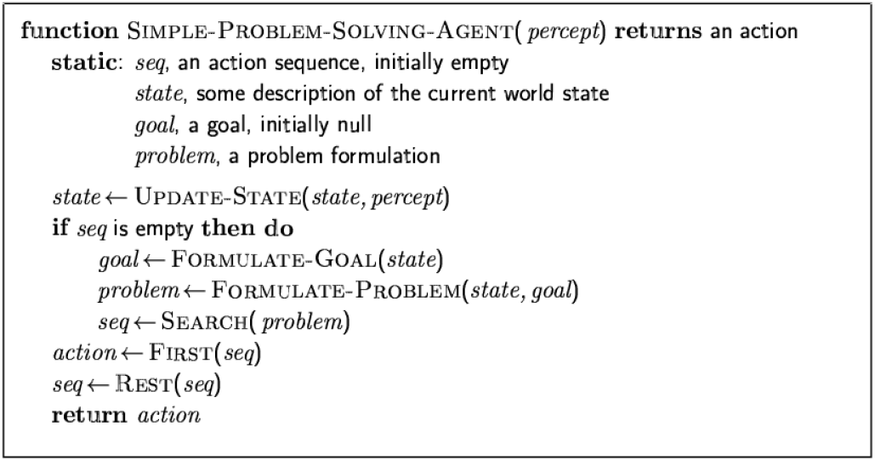
Problem solving agents

Slide 58
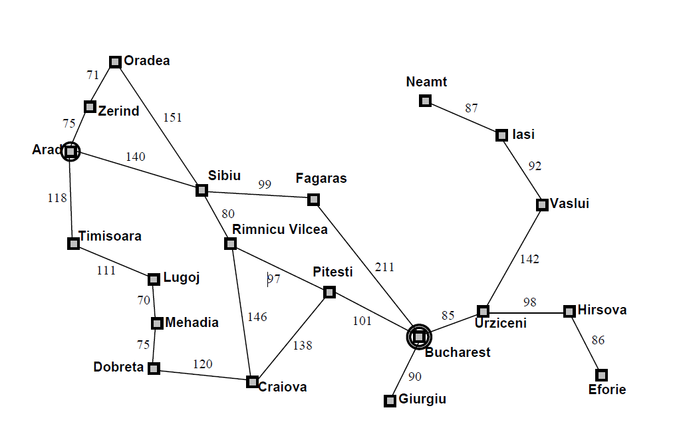
Example: Romania

Slide 59
Well-defined problems and solutions
A problem can be defined formally by four components
• Initial state that the agent starts in
– e.g. In(Arad)
• A description of the possible actions available to the agent
– Successor function – returns a set of <action,successor> pairs
– e.g. {<Go(Sibiu),In(Sibiu)>, <Go(Timisoara),In(Timisoara)>, <Go(Zerind), In(Zerind)>}
– Initial state and the successor function define the state space ( a graph in which the nodes are states and the arcs between nodes are actions). A path in state space is a sequence of states connected by a sequence of actions
• Goal test determines whether a given state is a goal state
– e.g.{In(Bucharest)}
• Path cost function that assigns a numeric cost to each path.
The cost of a path can be described as the some of the costs of the individual actions along the path – step cost – e.g. Time to go Bucharest

Slide 60
Problem Formulation
A solution to a problem is a path from the initial state to the goal state
• Solution quality is measured by the path cost function and an optimal solution has the lowest path cost among all solutions
• Real world is absurdly complex – state space must be abstracted for problem solving
• (Abstract) state = set of real states
• (Abstract) action = complex combination of real actions
– e.g., "Arad -> Zerind" represents a complex set of possible routes, detours, rest stops, etc.
• For guaranteed realizability, any real state "in Arad“ must get to some real state "in Zerind"
• (Abstract) solution =
– set of real paths that are solutions in the real world
• Each abstract action should be "easier" than the original problem

Slide 61
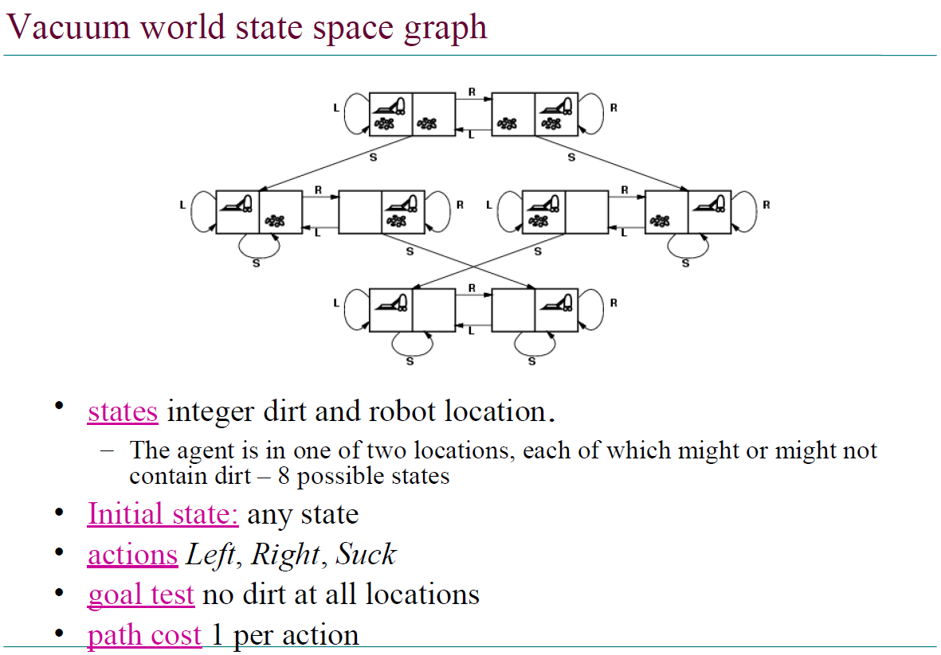

Slide 62
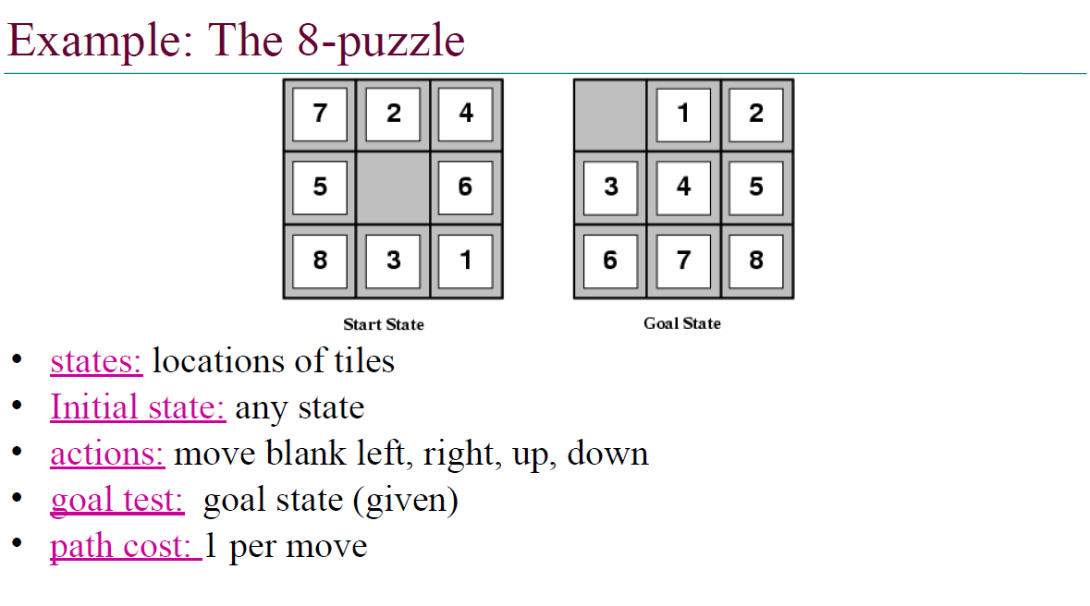

Slide 63
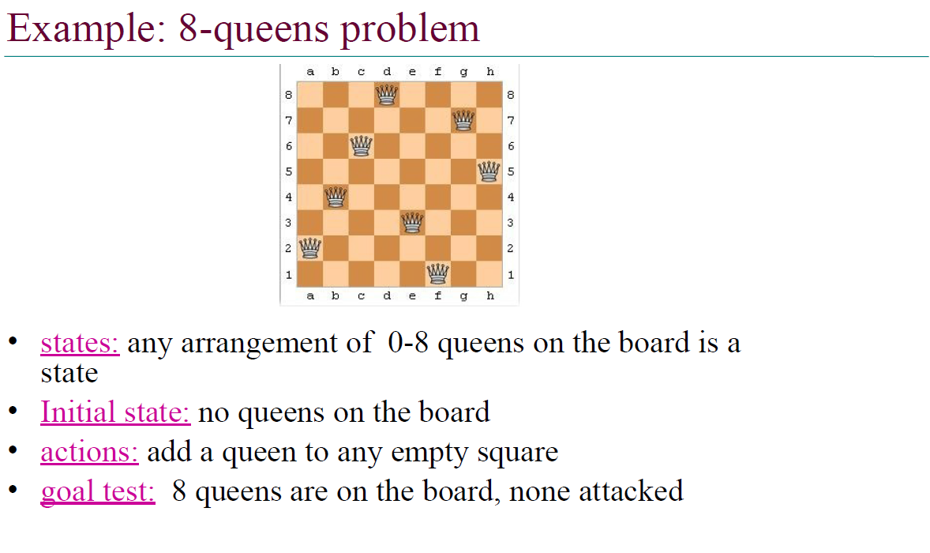

Slide 64
